Slide 1
Data Base Concepts
Why We need Database
What are different objects

Slide 2
What Are Database Objects?
A database object is any defined object in a database that is used to store or reference data. Some examples of database objects include tables, views, clusters, sequences, indexes, and synonyms. The table is this hour's focus because it is the primary and simplest form of data storage in a relational database.

Slide 3
What Is a Schema?
A schema is a collection of database objects (as far as this hour is concerned—tables) associated with one particular database username. This username is called the schema owner, or the owner of the related group of objects. You may have one or multiple schemas in a database. The user is only associated with the schema of the same name and often the terms will be used interchangeably. Basically, any user who creates an object has just created it in her own schema unless she specifically instructs it to be created in another one. So, based on a user's privileges within the database, the user has control over objects that are created, manipulated, and deleted. A schema can consist of a single table and has no limits to the number of objects that it may contain, unless restricted by a specific database implementation.

Slide 4
Table: The Primary Storage for Data
The table is the primary storage object for data in a relational database. In its simplest form, a table consists of row(s) and column(s), both of which hold the data. A table takes up physical space in a database and can be permanent or temporary.

Slide 5
Table Creation
CREATE TABLE EMPLOYEE_TBL (EMP_ID CHAR(9) NOT NULL, EMP_NAME VARCHAR (40) NOT NULL, EMP_ST_ADDR VARCHAR (20) NOT NULL, EMP_CITY VARCHAR (15) NOT NULL, EMP_ST CHAR(2) NOT NULL, EMP_ZIP INTEGER(5) NOT NULL, EMP_PHONE INTEGER(10) NULL, EMP_PAGER INTEGER(10) NULL);

Slide 6
Modifying Columns
There are many things to take into consideration when modifying existing columns of a table. Following are some common rules for modifying columns:
The length of a column can be increased to the maximum length of the given data type.
The length of a column can be decreased only if the largest value for that column in the table is less than or equal to the new length of the column.
The number of digits for a number data type can always be increased.
The number of digits for a number data type can be decreased only if the value with the most number of digits for that column is less than or equal to the new number of digits specified for the column.
The number of decimal places for a number data type can either be increased or decreased.
The data type of a column can normally be changed.

Slide 7
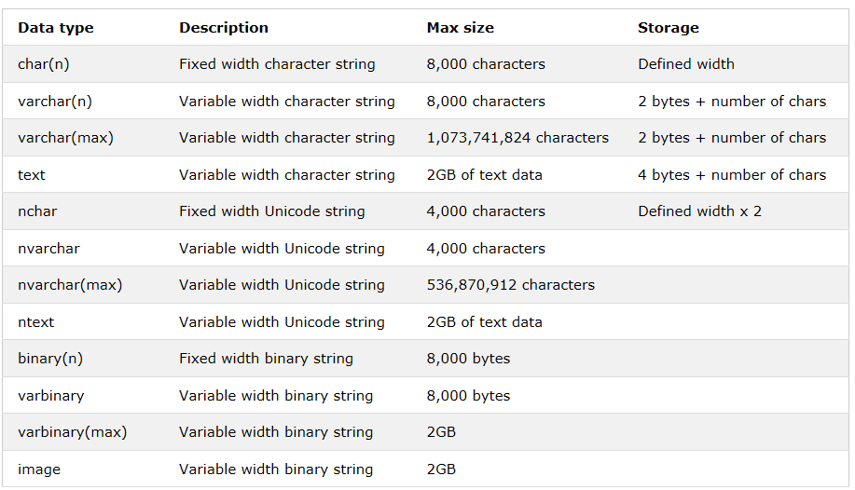
Data Type

Slide 8
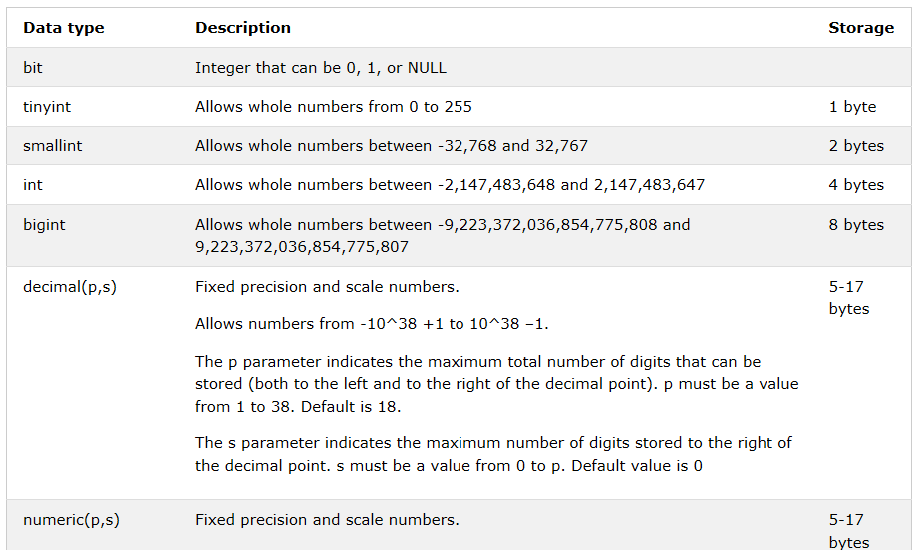
Data Type

Slide 9
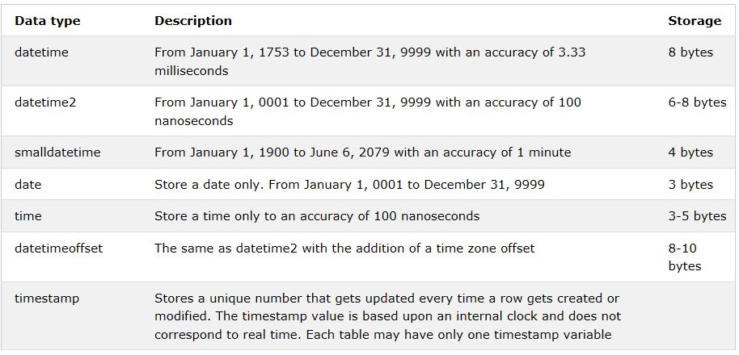
Data Type

Slide 10
Char Vs Varchar
When you are sure of Size , use Char
In case of Char performance is high

Slide 11
Primary Key Constraints
Primary key is the term used to identify one or more columns in a table that make a row of data unique. Although the primary key typically consists of one column in a table, more than one column can comprise the primary key. For example, either the employee's Social Security number or an assigned employee identification number is the logical primary key for an employee table. The objective is for every record to have a unique primary key or value for the employee's identification number. Because there is probably no need to have more than one record for each employee in an employee table, the employee identification number makes a logical primary key. The primary key is assigned at table creation.

Slide 12
Unique Constraints
A unique column constraint in a table is similar to a primary key in that the value in that column for every row of data in the table must have a unique value. Although a primary key constraint is placed on one column, you can place a unique constraint on another column even though it is not actually for use as the primary key.

Slide 13
Primary Key Vs Unique Key
UNIQUE constraints may be nullable. When you create a UNIQUE constraint, the database automatically creates a UNIQUE index. For MS SQL Server databases, a PRIMARY KEY will generate a unique CLUSTERED INDEX

Slide 14
Foreign Key Constraints
A foreign key is a column in a child table that references a primary key in the parent table. A foreign key constraint is the main mechanism used to enforce referential integrity between tables in a relational database. A column defined as a foreign key is used to reference a column defined as a primary key in another table.

Slide 15
Check Constraints
Check (CHK) constraints can be utilized to check the validity of data entered into particular table columns. Check constraints are used to provide back-end database edits, although edits are commonly found in the front-end application as well. General edits restrict values that can be entered into columns or objects, whether within the database itself or on a front-end application. The check constraint is a way of providing another protective layer for the data.

Slide 16
Q & A
What is difference between Primary Key and Unique Constraints
A column add with Not Null constraint , Will it be allowed
Is Primary Key good for tables

Slide 17
Index
An index is a copy of selected columns of data from a table that can be searched very efficiently that also includes a low-level disk block address or direct link to the complete row of data it was copied from. Some databases extend the power of indexing by letting developers create indexes on functions or expressions.

Slide 18
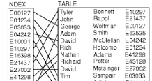
Index

Slide 19
Index Advantage
An index is used to speed up the performance of queries. It does this by reducing the number of database data pages that have to be visited/scanned. In SQL Server, a clustered index determines the physical order of data in a table. There can be only one clustered index per table.

Slide 20
Non-clustered & Clustered
The data is present in arbitrary order, but the logical ordering is specified by the index. The data rows may be spread throughout the table regardless of the value of the indexed column or expression. The non-clustered index tree contains the index keys in sorted order, with the leaf level of the index containing the pointer to the record (page and the row number in the data page in page-organized engines; row offset in file-organized engines).
In a non-clustered index,
The physical order of the rows is not the same as the index order.
The indexed columns are typically non-primary key columns used in JOIN, WHERE, and ORDER BY clauses.
There can be more than one non-clustered index on a database table.
Clustering alters the data block into a certain distinct order to match the index, resulting in the row data being stored in order. Therefore, only one clustered index can be created on a given database table. Clustered indices can greatly increase overall speed of retrieval, but usually only where the data is accessed sequentially in the same or reverse order of the clustered index, or when a range of items is selected.
Since the physical records are in this sort order on disk, the next row item in the sequence is immediately before or after the last one, and so fewer data block reads are required. The primary feature of a clustered index is therefore the ordering of the physical data rows in accordance with the index blocks that point to them. Some databases separate the data and index blocks into separate files, others put two completely different data blocks within the same physical file(s).

Slide 21
Clustered Vs Non Clustered
A clustered index is a special type of index that reorders the way records in the table are physically stored. Therefore table can have only one clustered index. The leaf nodes of a clustered index contain the data pages.
A non clustered index is a special type of index in which the logical order of the index does not match the physical stored order of the rows on disk. The leaf node of a non clustered index does not consist of the data pages. Instead, the leaf nodes contain index rows.”

Slide 22
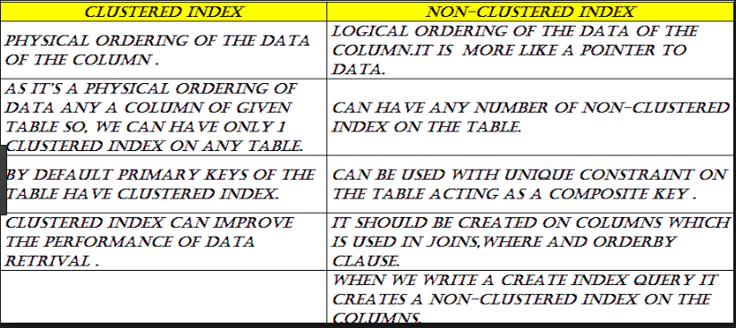
Clustered Vs Non Clustered

Slide 23
Q & A
Is this Good to have Index everytime
How many Clustered index can be created

Slide 24
View
A database view is a searchable object in a database that is defined by a query. Though a view doesn't store data, some refer to a views as “virtual tables,” you can query a view like you can a table. A view can combine data from two or more table, using joins, and also just contain a subset of information.

Slide 25
Procedure
The SQL CREATE PROCEDURE statement is used to create stored procedures that are stored in the database. It is set of instruction needs to be executed. Procedure is not going to return the value

Slide 26
What is a function in SQL Server?
Creates a user-defined function in SQL Server and Azure SQL Database. A user-defined function is a Transact-SQL or common language runtime (CLR) routine that accepts parameters, performs an action, such as a complex calculation, and returns the result of that action as a value

Slide 27
Some common Function
Aggregate Functions
Sum
Avg
Count
Max
Min

Slide 28
Some common functions
Trim,Ltrim,Rtrim
Substr,mid
Chr
Val
isnull
Replace
Lower/upper
Round

Slide 29
Conditional Function
IIF Function
Argument | Description
expr | Required. Expression you want to evaluate.
truepart | Required. Value or expression returned if expr is True.
falsepart | Required. Value or expression returned if expr is False.

Slide 30
Q & A
What is difference between Procedure and Function
Does Aggregate function always requires Group by clause

Slide 31
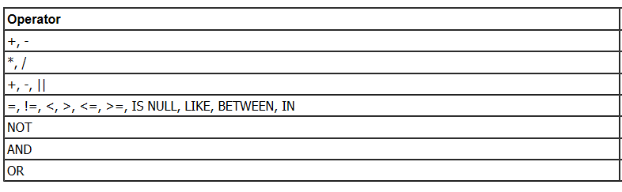
Operators

Slide 32
Temp Table
Global temp tables are available to all SQL Server sessions or connections (means all the user). These can be created by any SQL Server connection user and these are automatically deleted when all the SQL Server connections have been closed. Global temporary table name is stared with double hash ("##") sign

Slide 33
Temp Table
Local temp tables are available to the current procedure or function. Local temporary table name is stared with single hash ("#") sign

Slide 34
Q & A
When we can create Local Temp table
Does Temp table requires space
Can we create index on Temp table

Slide 35
Triggers
A trigger is a special kind of stored procedure that automatically executes when an event occurs in the database server. DML triggers execute when a user tries to modify data through a data manipulation language (DML) event. DML events are INSERT, UPDATE, or DELETE statements on a table or view

Slide 36
Triggers
When Trigger is invoked Inserted and Deleted table is created

Slide 37
Thank You

